Slide 1
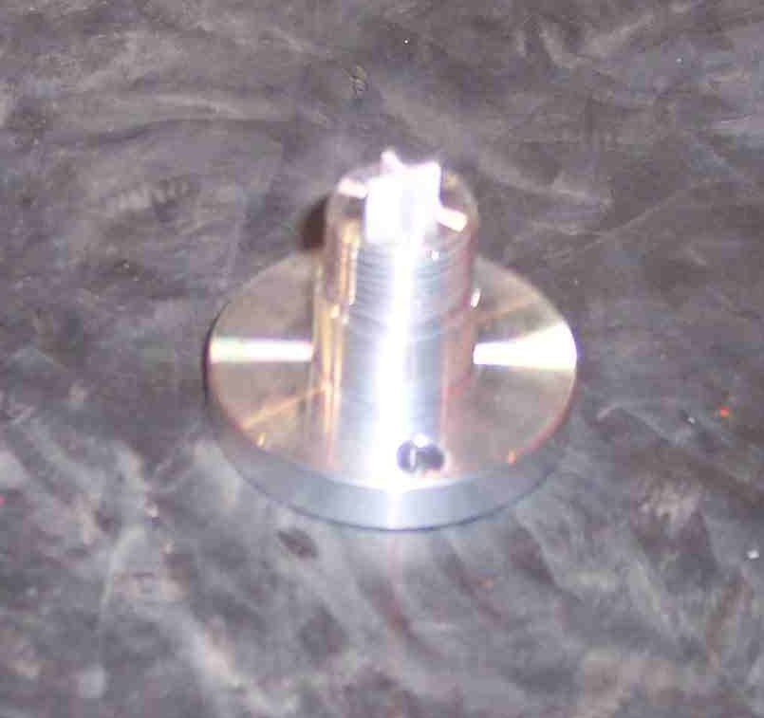
SIEMENS
HVCB SPARES
NRV for Pole
72.5KV,40KA, 145KV & 245KV CB
S4804849701

